Slide 1
Time Use
Truths & Myths
about time use
in modern life

Slide 2
INDEX
DATA SOURCE & VARIABLES ANALIZED
HYPOTHESIS
DISTRIBUTION OF TIME WORLDWIDE
1.Sleep time
2.Holidays
4.TIME USE - GENDER
Spain
Worldwide
5.TIME USE - TIME ON CHILDCARE
6.TIME USE - RELATIONSHIPS BY AGE
7.TIME USE - SCREEN TIME
8.CONCLUSIONS

Slide 3
My name is Ángela, I work as an Education Coordinator in a Design University from Barcelona,

Slide 4
My name is Ángela, I work as an Education Coordinator in a Design University from Barcelona,
and this last year I’m super into PS4,
face massages & snorkeling

Slide 5
TIME USE - DATA SOURCE & VARIABLES
1.1 DATA SOURCE
Datasets are from Organization for Economic Cooperation & Development
Time Use Database OECD (2020)
Dataworldbank
35 Countries
5 Variables
5 Datasets
Men & Women
Aged 15 to 64
Latest Year
DATASETS

Slide 6
TIME USE - DATA SOURCE & VARIABLES
1.2 DATA SOURCE
PAID WORK OR STUDY
Time spent in paid work or learning activities includes: paid work (all jobs); job search; attendance of classes at all levels of instruction (pre-primary, primary, secondary, technical and vocational, higher education, extra or make up classes); research/homework; travel to and from work/study; other paid work or study-related activities.
UNPAID WORK
Time spent in unpaid work includes: routine housework; shopping; care for household members; child care; adult care; care for non-household members; volunteering; travel related to household activities; other unpaid activities.
PERSONAL CARE
Time spent in personal care includes: activities required by the individual in relation to biological needs (sleeping, eating, resting etc.); performing own personal or household health-care and maintenance or receiving this type of care; travel related to personal care activities in relation to spiritual/religious care; doing nothing, resting, relaxing; meditating, thinking, planning.
LEISURE
Time spent socializing; attending cultural, entertainment and sports events; in hobbies, games and other pastime activities; participating in sports and outdoor activities; using mass media; performing other leisure activities.
OTHER
Time spent in spiritual and religious activities and in civic obligations; or in unspecified activities.
VARIABLES

Slide 7
2. HYPOTHESIS
¿How do people spend their time in modern life?
Can we find similarities & differences between countries? Is there any visible trend?
Percentages that different countries spend working, sleeping, watching Tv or doing housework
Differences between men & women using their free time. What about Spanish?
How much time are we spending with our different relationships? & with our children?

Slide 8
2. HYPOTHESIS
¿How do people spend their time in modern life?
Can we find similarities & differences between countries? Is there any visible trend?
Percentages that different countries spend working, sleeping, watching Tv or doing housework
Differences between men & women using their free time. What about Spanish?
How much time are we spending with our different relationships? & with our children?
DESTROYING MYTHS & BELIEFS
Is is true that because everything is faster now, we work, sleep and spend more time alone or less with our kids than before?

Slide 9
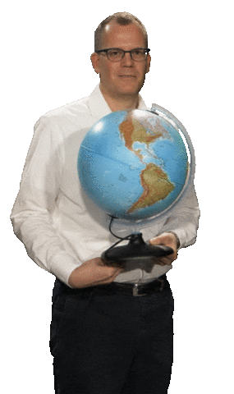
Time Use
Distribution
Worldwide

Slide 10
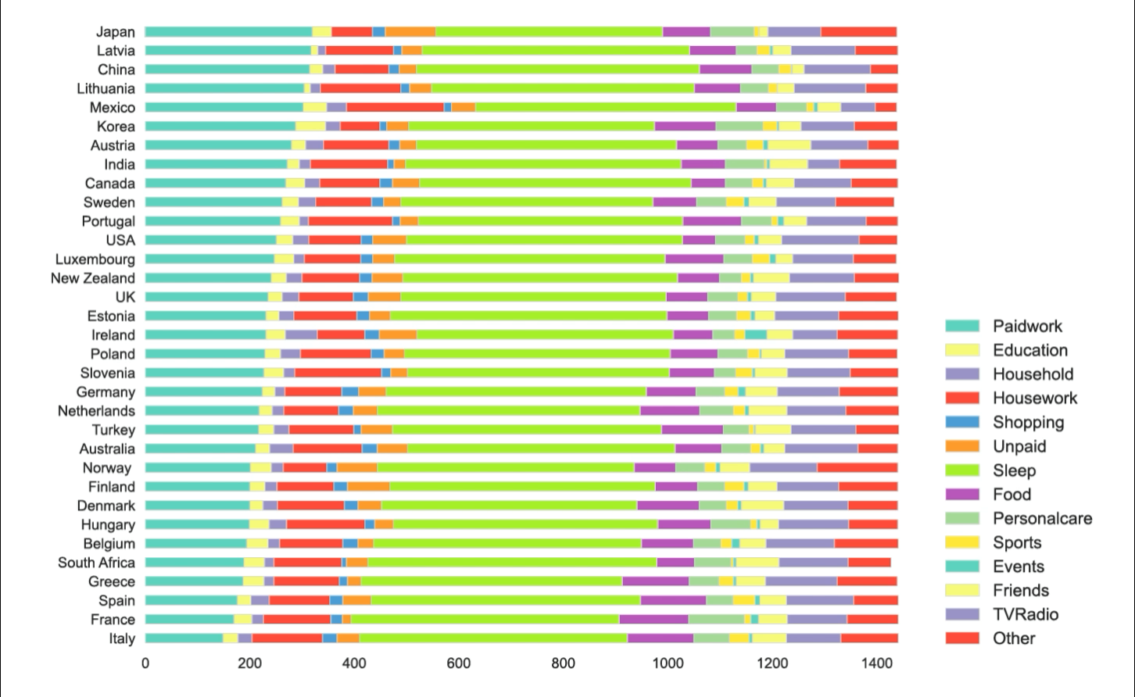
TIME USE - DISTRIBUTION WORLDWIDE
Similarities on the daily activities around the globe
Common trends: work, rest & fun
*Possible cultural differences
Provides important info for understanding general wellbeing
Differences in demographic, education & economics all contribute to inequalities in work & time use
*The French seem to spend much more time eating than the British – and in this respect the data actually goes in line with stereotypes about food culture. People in France, Greece, Italy and Spain report spending more time eating than people in most other European countries. The country where people spend the least time eating and drinking is the USA (63 minutes).

Slide 11
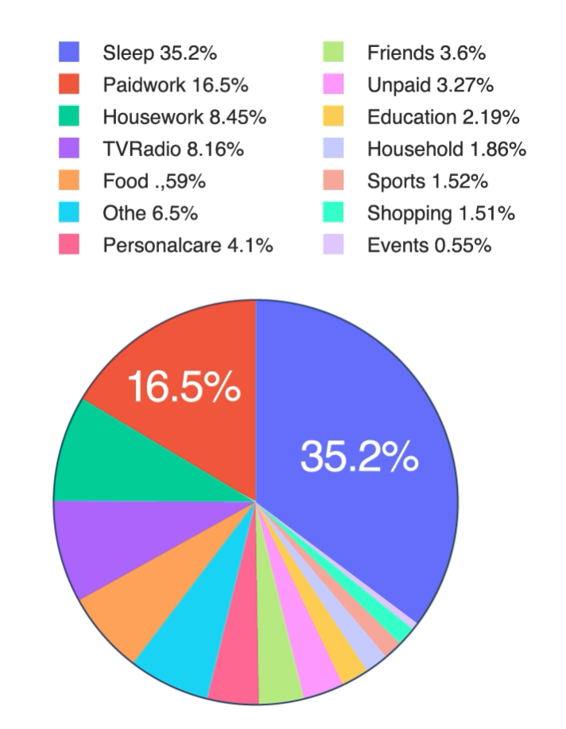
TIME USE - DISTRIBUTION WORLDWIDE

Slide 12
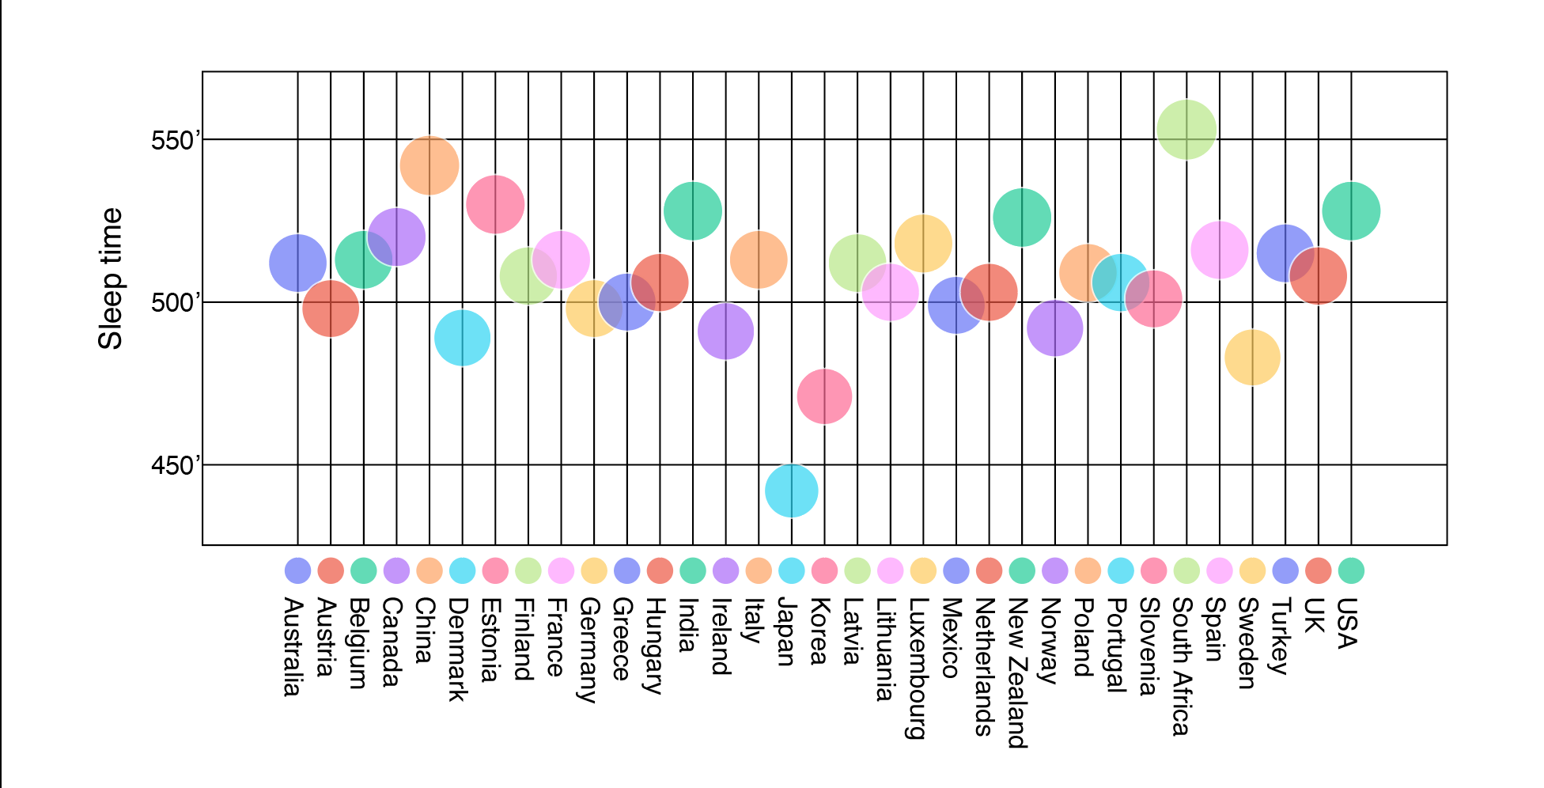
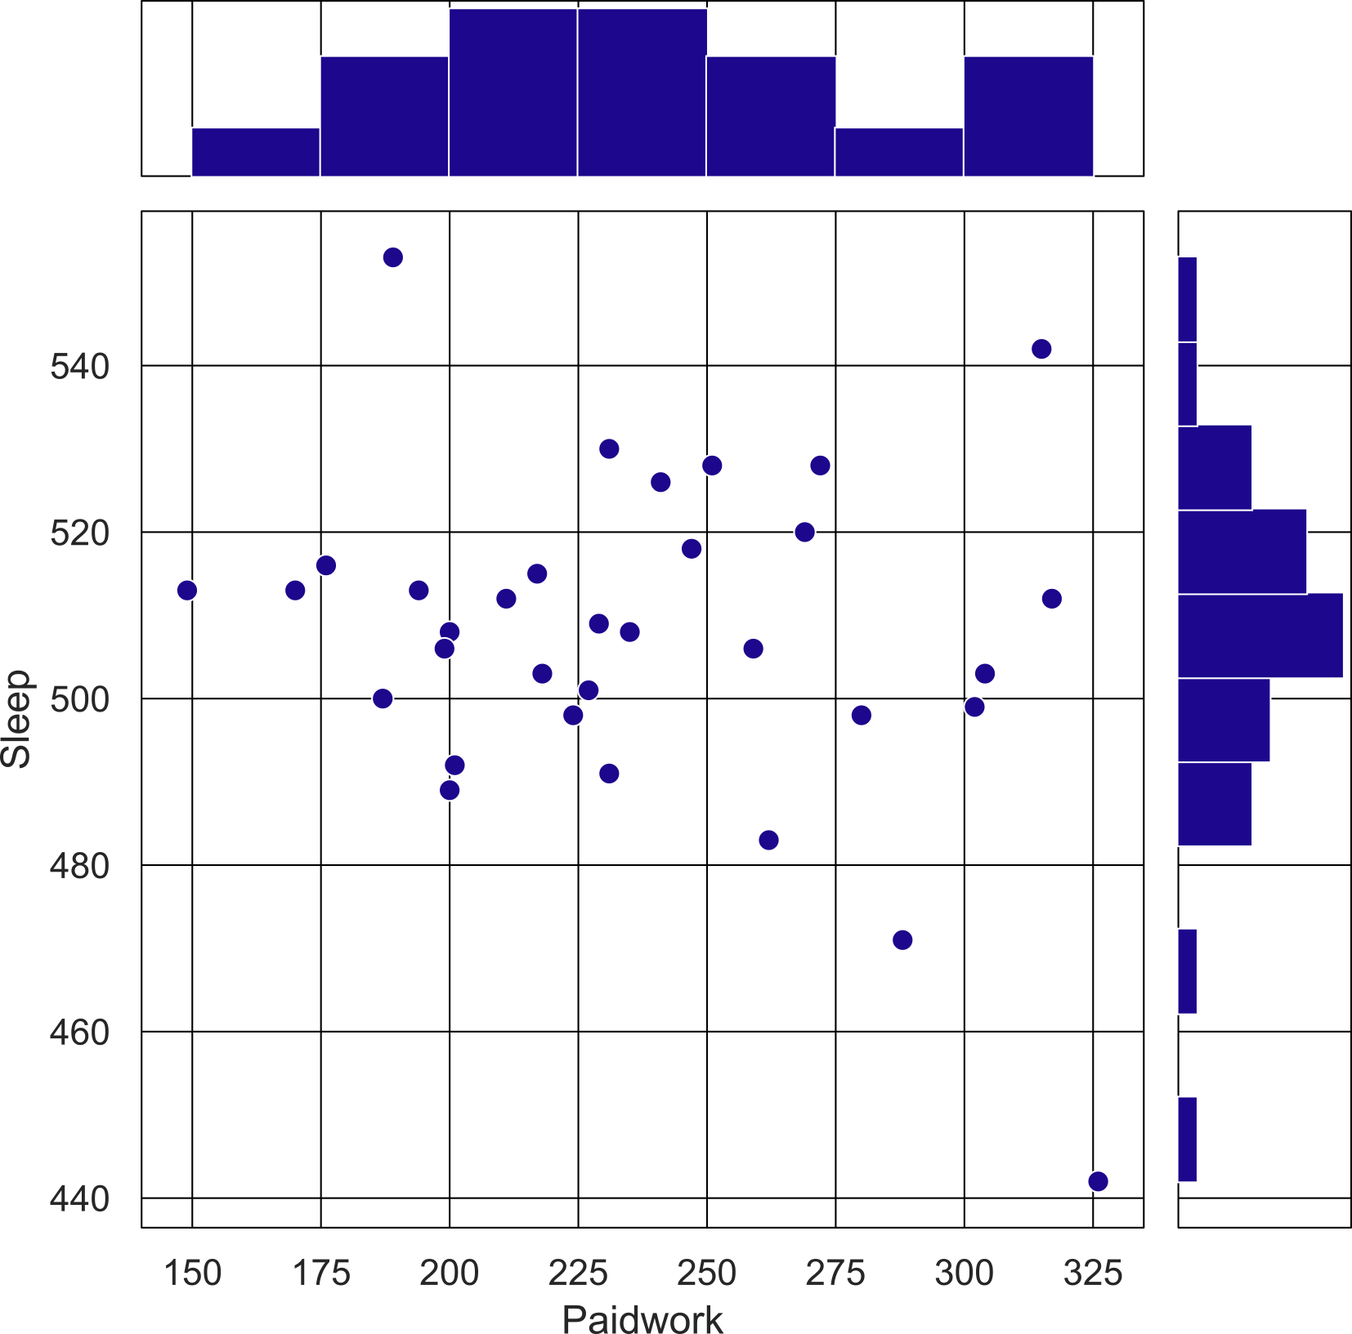
TIME USE - DISTRIBUTION WORLDWIDE
1.1 Sleep time
Sleep AVR Time
7hs AVR Japan vs 9hs in South Africa
No really a correlation between Sleep
& Paidwork
More time working doesn’t necessarily means less sleep
It's one of these things where you have an expectation: "A 24/7 society means you sleep less",' and that is demonstrably not the case.
*Not all developed economies rest well; South Korea and Japan are the world’s worst countries when it comes to getting a good night’s sleep. The problem of sleeplessness in Japan is well-documented, particularly in relation to the phenomenon of karoshi – death caused by lack of sleep.

Slide 13
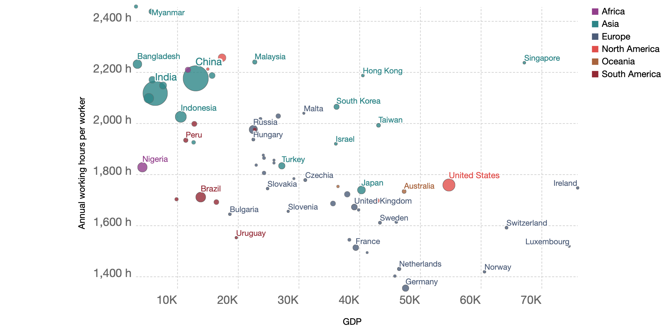
TIME USE - DISTRIBUTION WORLDWIDE
1.2 Working hours & Holidays
Visible correlation between GDP & Annual hours worked
Richer countries can afford to work less in general
*People in Switzerland, one of the richest countries in the world, have an average income that is more than 20-times higher than that of people in Cambodia

Slide 14
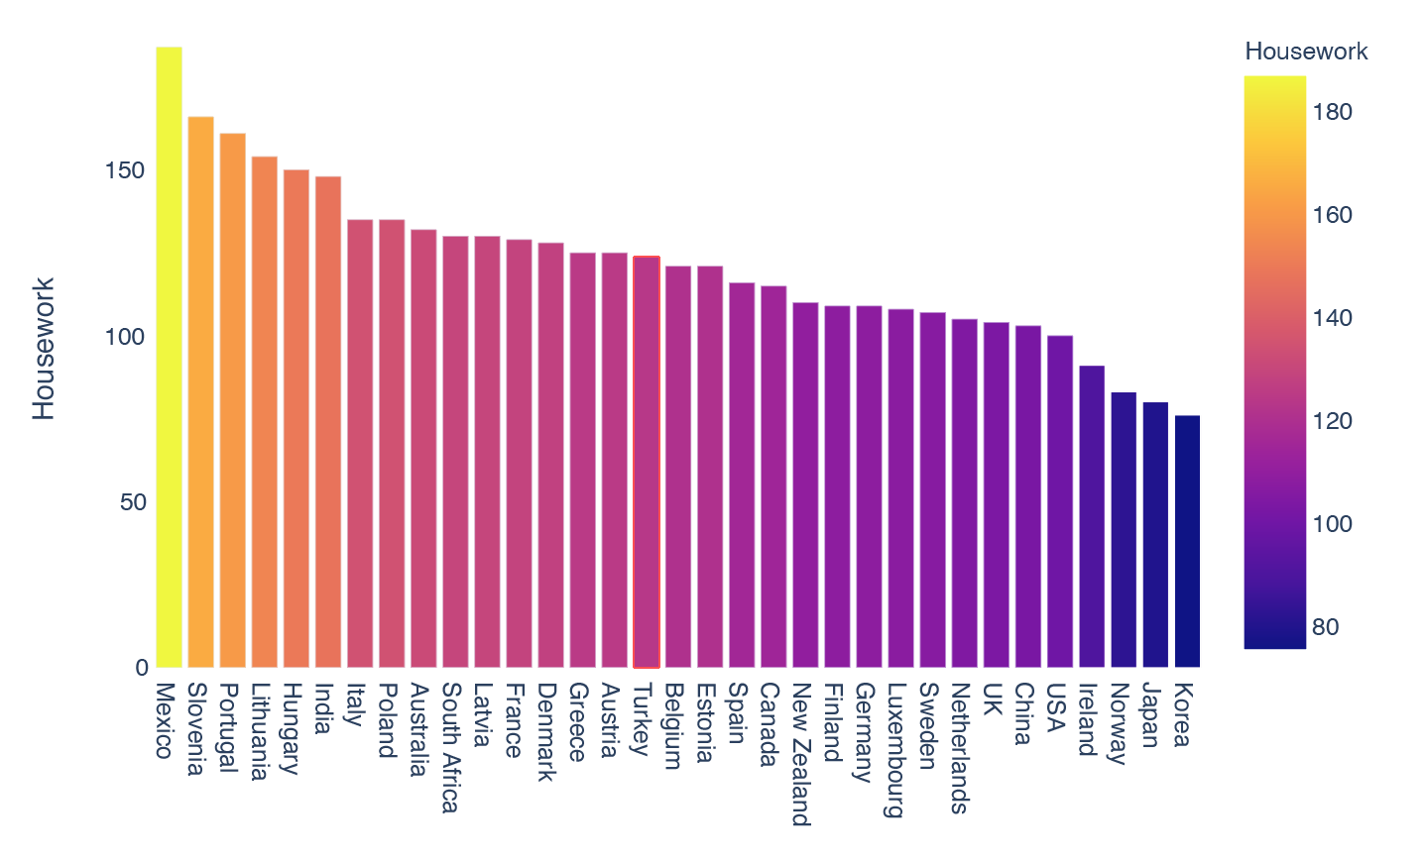
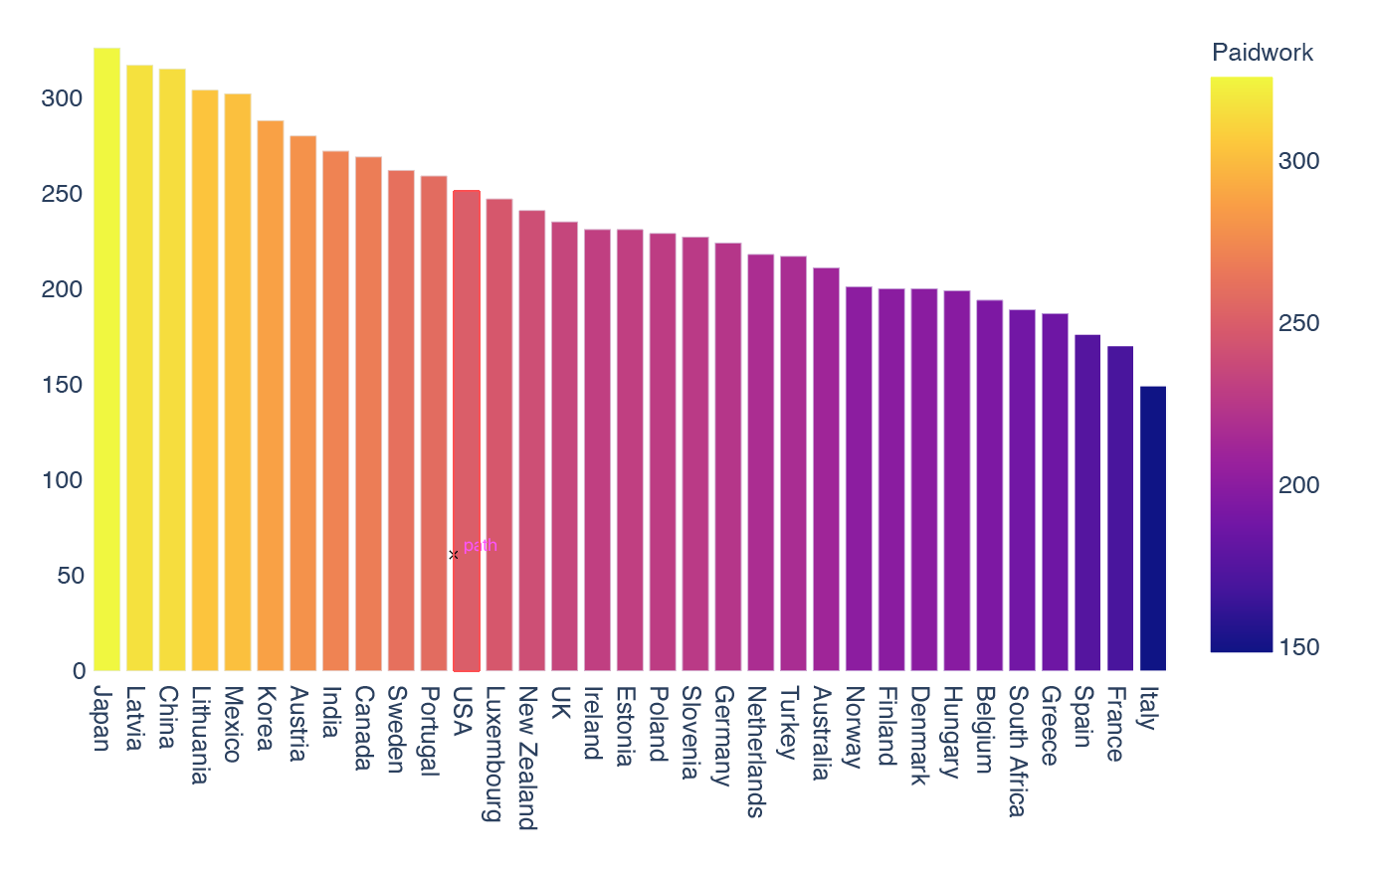
TIME USE - DISTRIBUTION WORLDWIDE
Workers now work 20 to 30 hours less every week than in the 19th century
The OECD estimates that on average, 22% of all Japanese employees work more than 50 hours a week

Slide 15
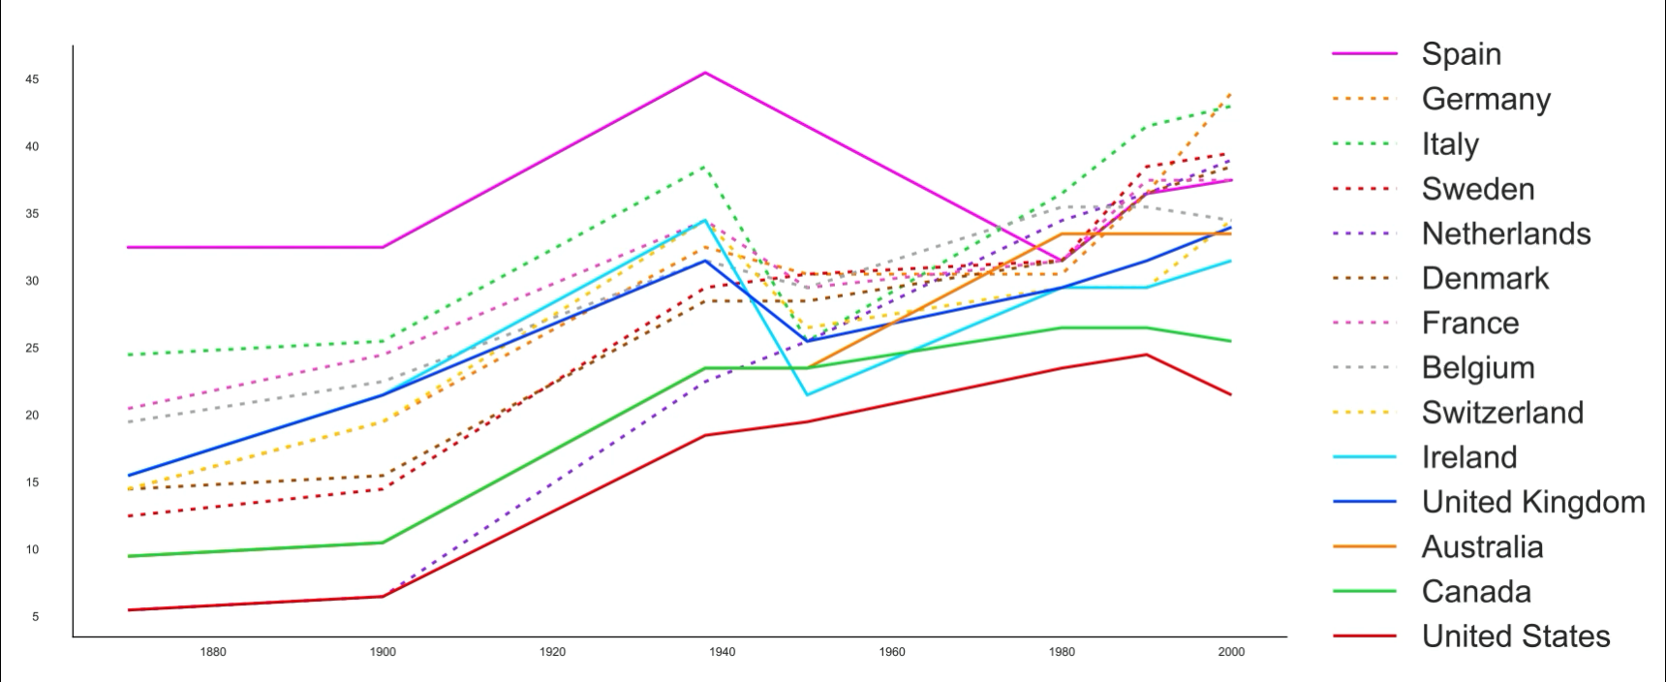
TIME USE - DISTRIBUTION WORLDWIDE
1.2 Holidays
From Y1400
2nd world war
Start of the 2 day weekend
Ys1800_2000
vacations &
national holidays
increased

Slide 16
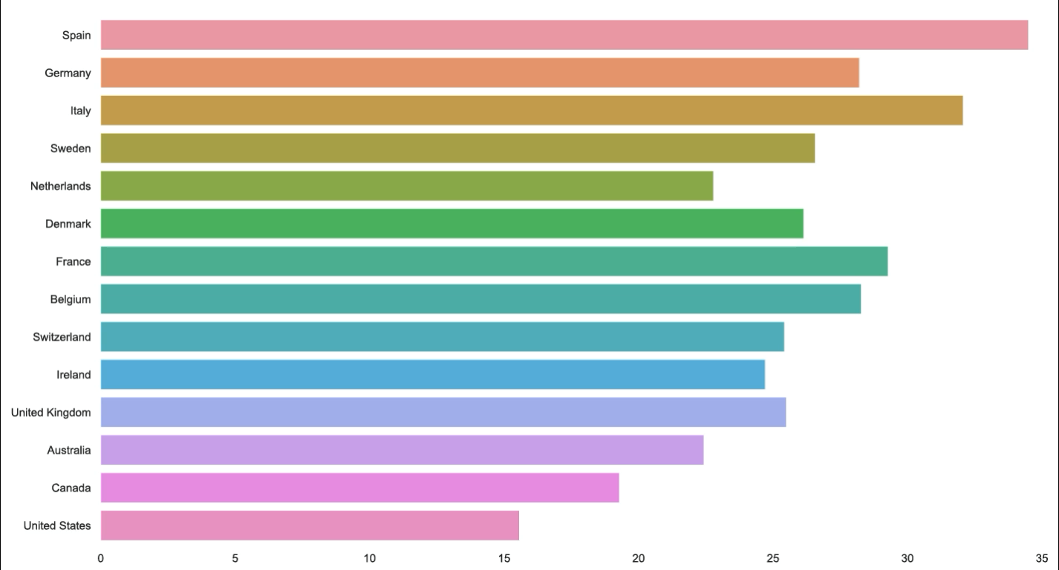
TIME USE - DISTRIBUTION WORLDWIDE

Slide 17

Time Use
Gender

Slide 18
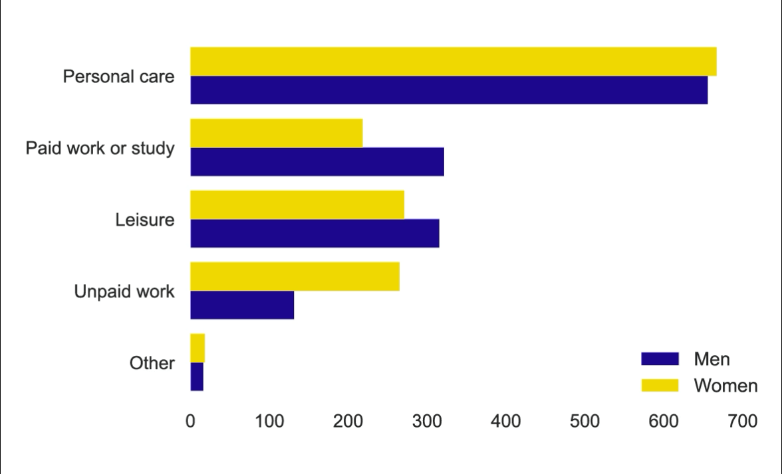
TIME USE - GENDER WORLDWIDE
STILL GENDER INEQUALITIES
Gender gaps worldwide are in:
Paidwork
Leisure
Unpaid work
Men not taking their paternal leaves
Women not reporting caring jobs such as childcare, cleaning, caring
*PERSONAL CARE
Time spent in personal care includes: activities required by the individual in relation to biological needs (sleeping, eating, resting etc.); performing own personal or household health-care and maintenance or receiving this type of care; travel related to personal care activities in relation to spiritual/religious care; doing nothing, resting, relaxing; meditating, thinking, planning.

Slide 19
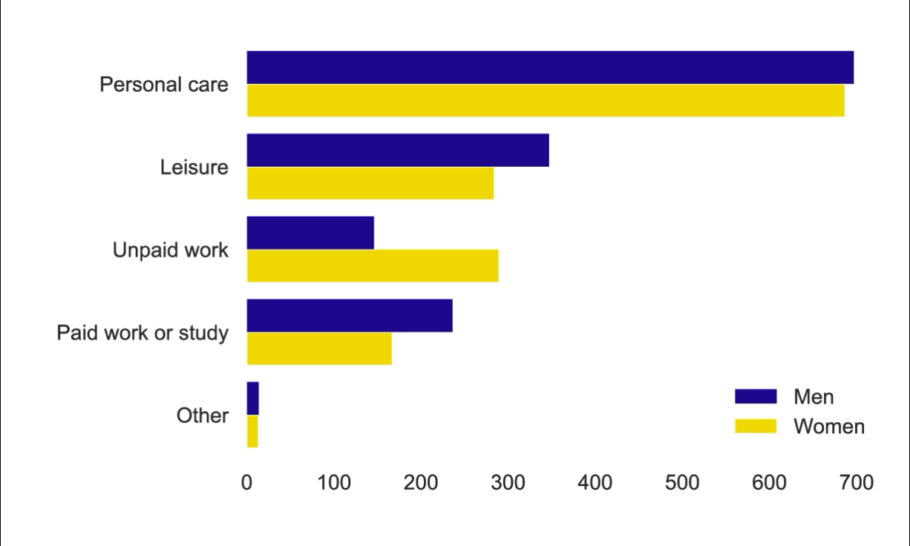
TIME USE - GENDER SPAIN
16%vs11%
PAIDWORK
19%vs24%
LEISURE TIME
10%vs 20%
UNPAID WORK
*PERSONAL CARE
Time spent in personal care includes: activities required by the individual in relation to biological needs (sleeping, eating, resting etc.); performing own personal or household health-care and maintenance or receiving this type of care; travel related to personal care activities in relation to spiritual/religious care; doing nothing, resting, relaxing; meditating, thinking, planning.

Slide 20

Time Use
Childcare

Slide 21
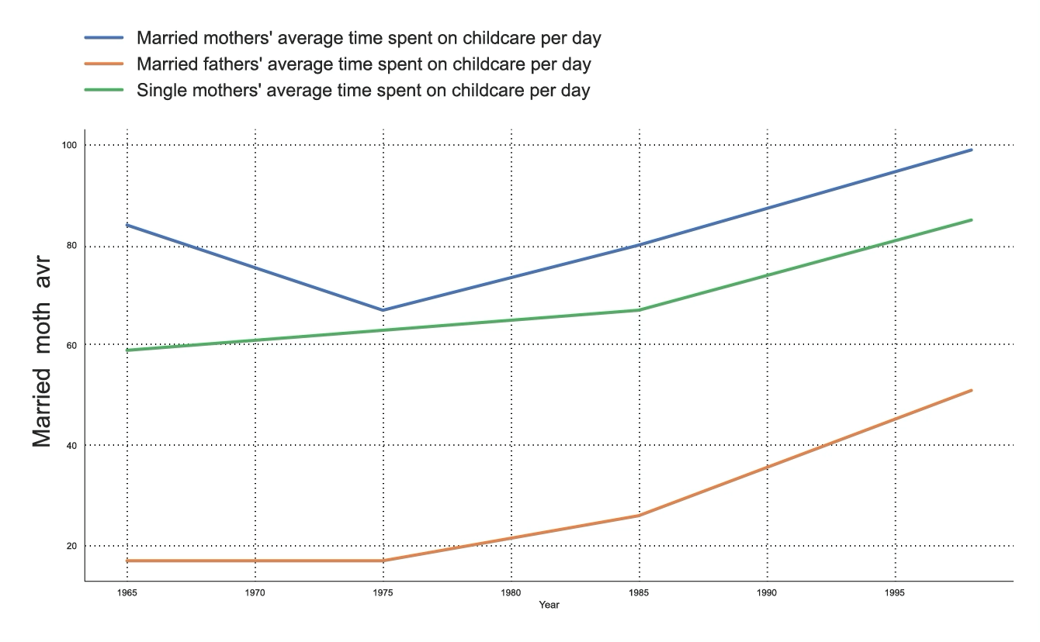
TIME USE - CHILDCARE
CLEAR INCREASE OF TIME SPENT WITH OUR CHILDREN BOTH M&W
Women working outside home
Rise of single parenting
Still women more spend more time
More educated parents = More time

Slide 22

Time Use
Relationships
by age

Slide 23
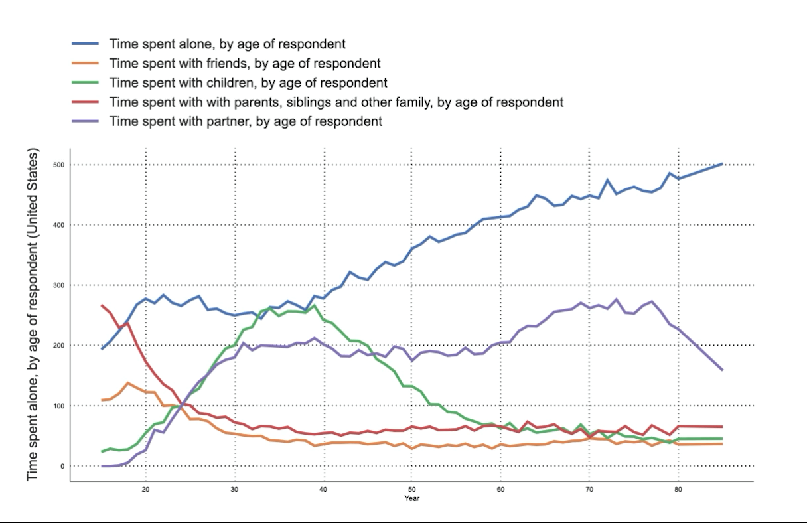
TIME USE - CHILDCARE
DRAMATIC INCREASE OF TIME SPENT ALONE WHEN GET OLDER
Entering retirement around 60
30/40 & 50s much time with partners, children & co-workers
We need contact & interaction in order to maintain wellbeing

Slide 24
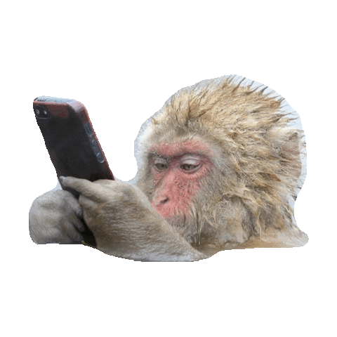
Time Use
Screentime

Slide 25
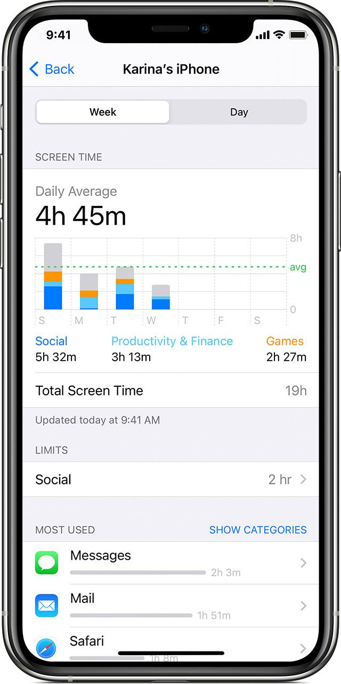
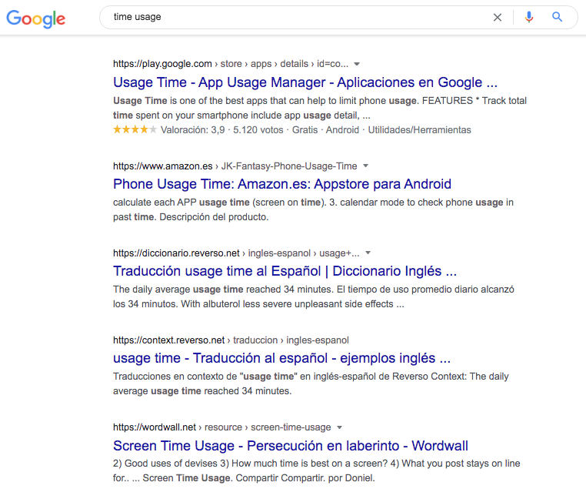
Pie de foto
Pie de foto

Slide 26
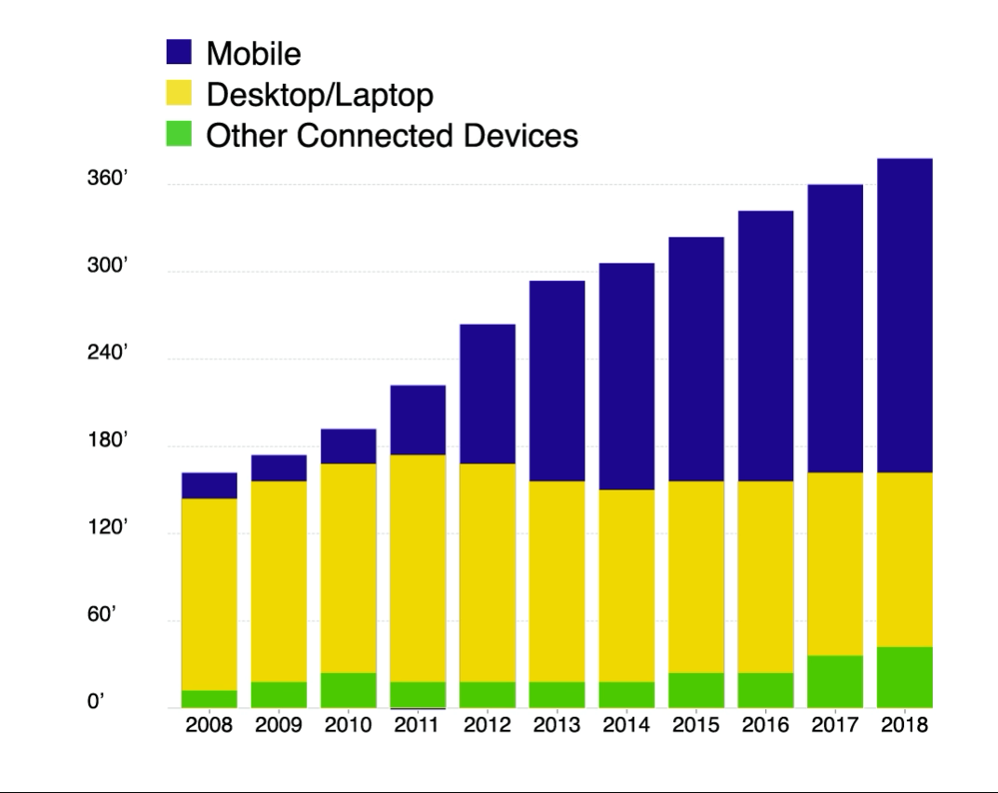
TIME USE - CHILDCARE
Survey respondents Feb 2021
50%
AVR 5-6hs including work related
22%
AVR 3-4hs including work related
5%
Less than 1h

Slide 27
CONCLUSIONS
In general we can say that there are similarities regarding daily activities around the globe.
There’s definitely still gender differences to fight about about on time use regarding leisure, paid & unpaid work.
We do sleep even more than in the last 50 years.
Trump makes do with four hours. The rest of us, get an average of seven hours and 12 minutes of sleep according to 1m worldwide users of Sleep Cycle, an app that tracks night-time sound and movement. We do sleep even more than in the last 50 years.

Slide 28
CONCLUSIONS
In general we can say that there are similarities regarding daily activities around the globe.
There’s definitely still gender differences to fight about about on time use regarding leisure, paid & unpaid work.
We do sleep even more than in the last 50 years.
Trump makes do with four hours. The rest of us, get an average of seven hours and 12 minutes of sleep according to 1m worldwide users of Sleep Cycle, an app that tracks night-time sound and movement. We do sleep even more than in the last 50 years.
^{More holidays & vacations}
Rather than working more than ever, workers in many countries today work much less than in the past 150 years. There are huge inequalities within and across countries, but substantial progress has been made.
Longer time with our children, regardless of gender
Dramatic increase on mobile phone use, with an average of 5hs a day.

